Slide 1
I want to hire a Kansas licensed school librarian. What knowledge and skills should I expect?
Mirah J. Dow
Professor
School of Library and Information Management
Emporia State University
mdow@emporia.edu

Slide 2
School libraries are a big part of the U. S. educational, recreational, and informational infrastructure.
Public Libraries | 9,082
Academic Libraries | 3,793
School Libraries | 98,460
Special Libraries | 6,966
Armed Forces Libraries | 252
Government Libraries | 934
Total | 119,487
American Library Association, Number of Libraries in the United States retrieved from
http://www.ala.org/tools/libfactsheets/alalibraryfactsheet01

Slide 3
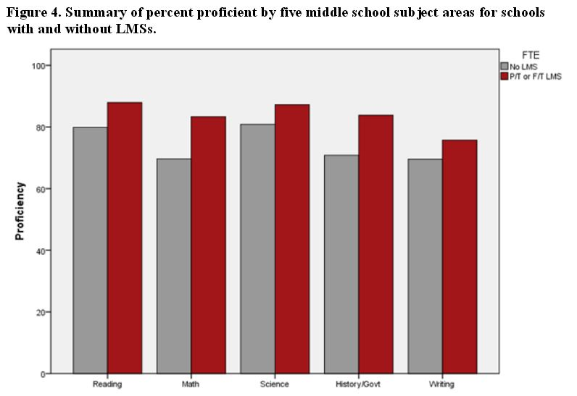
Nationwide, quantitative and qualitative measures indicate that school librarians matter.
Kansas Study
Dow, M. J., Lakin, J. M., & Court, S. C. (2012). School librarian staffing levels and student
achievement as represented in 2006-09 Kansas Annual Yearly Progress data. School Library Research, 15. Retrieved from http://www.ala.org/aasl/slr.

Slide 4
KANSAS SLMS licensure programs: ESU, PSU, FHSU, WSU
Emporia State University
School of Library and Information Management
Master of Library Science
36 graduate credit hours (28 credits SLMS requirements)
reviewed and approved by
American Library Association
Council for the Accreditation of Educator Preparation
Kansas Department of Education
www.slim.emporia.edu

Slide 5
MLS Program Learning Outcomes
Foundations of the Profession
Reference Resources (print and electronic)
Reference and User Services
Organization of Recorded Knowledge and Information
Technology Knowledge and Skills
Research
Administration and Management

Slide 6
Information Access and Retrieval 24 Assessed Threshold Performance Skills

Slide 7
What do school librarians do?
School librarian is
a teacher, not a paraprofessional.
a local leader in school learning and achievement.
an instructional partner with content area teachers.
specialized in information and technology skills instruction in all assessed content areas.

Slide 8
How do teachers and librarians
teach together?
Dow, M. J., (2013). Effective use of first principles of instruction. School Library Monthly, 29(8), 8-10.
Dow, M. J. (2010). School librarians teach subject area 10: Computer and information sciences. School Library Monthly, 27(2), 5-8.

Slide 9
What do school librarians teach?
Information and technology skills instruction based on a comprehensive review of content standards addressing what today’s children and youth will need for work and life.
What has changed?
University curriculum has evolved to reflect current trends. KSDE and the Kansas Association of School Librarians are well-known for offering up-to-date professional learning opportunities.
What should you do?
It is up to school administrators to hire licensed school librarians. Please give school librarians the roles and responsibilities they are qualified for and prepared to do.
Licensed school library media specialists will, with your support, be trailblazers for making Kansas schools the best in the world.

Slide 10
I want to hire a Kansas licensed school librarian. What knowledge and skills should I expect?
Today’s handout and presentation available at
http://tinyurl.com/zw9opuh
Questions? Please contact
Mirah Dow
mdow@emporia.edu
October 12, 2016

